Slide 1
Lesson 10:Searching Part 2: Finding One Record and Filling in the form.
by Lambert, Scott

Slide 2
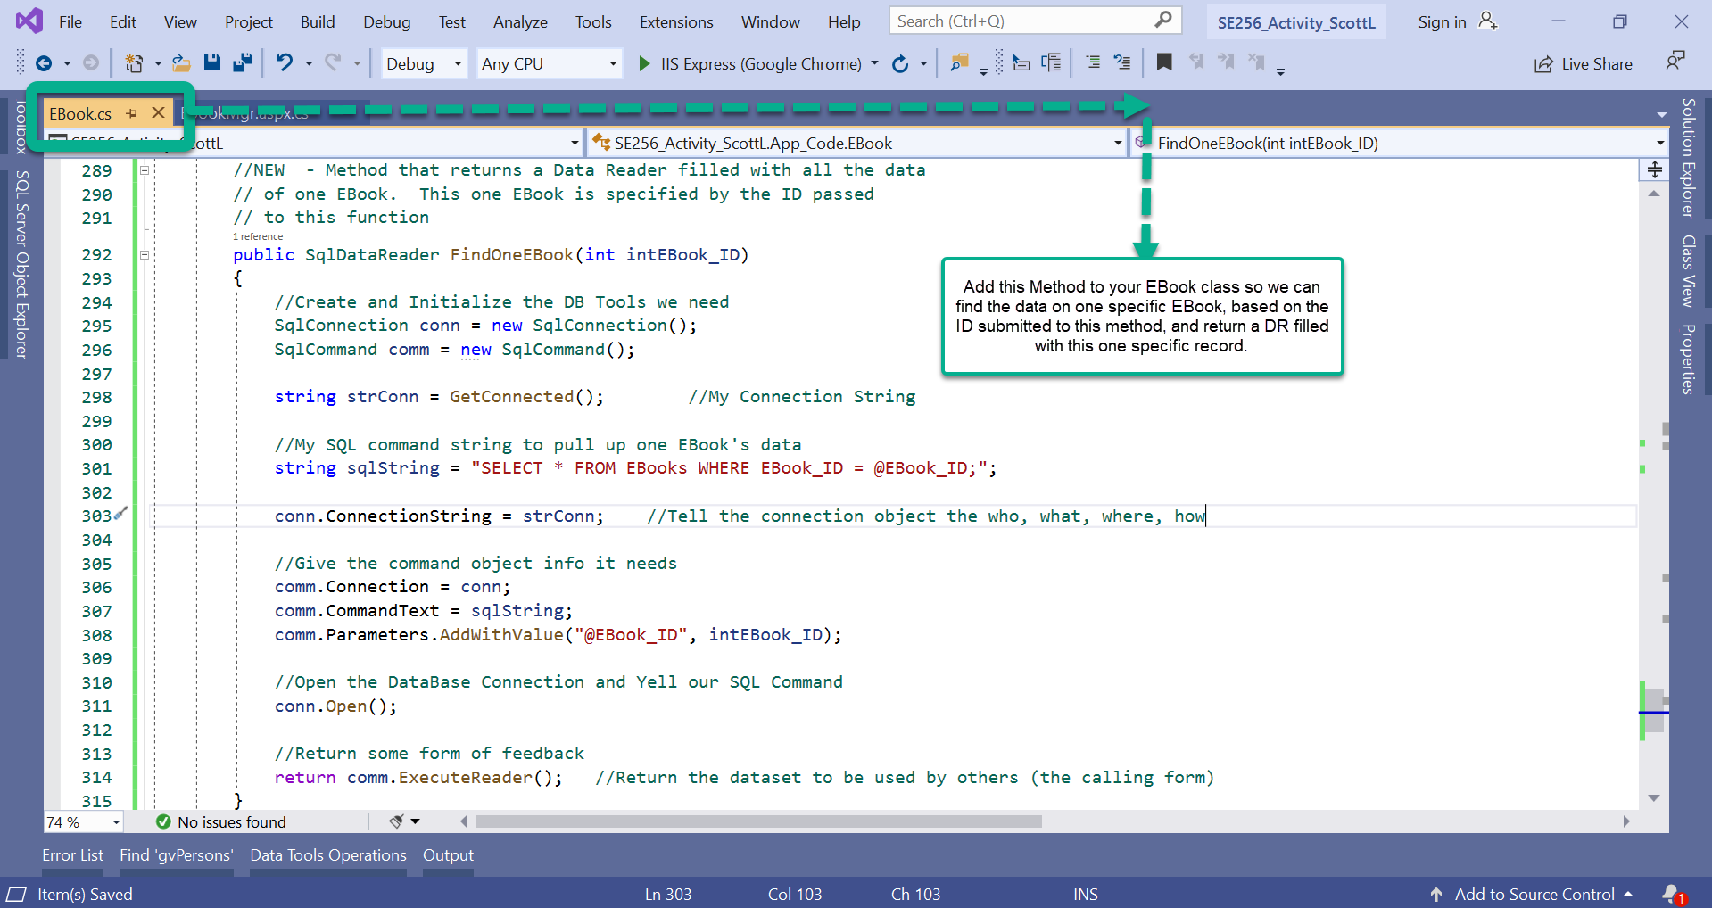

Slide 3
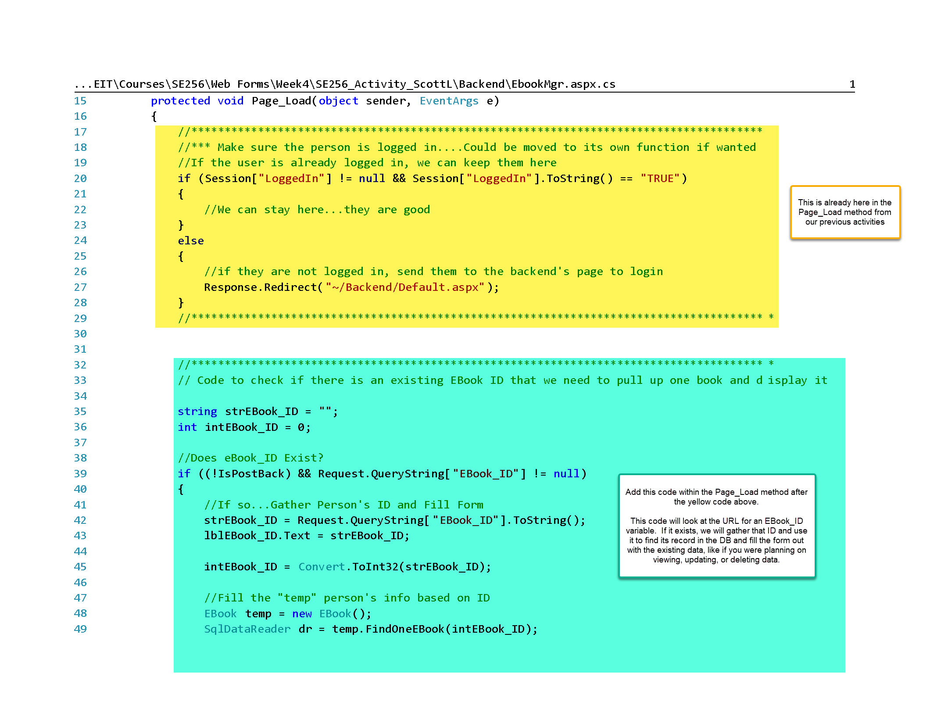

Slide 4
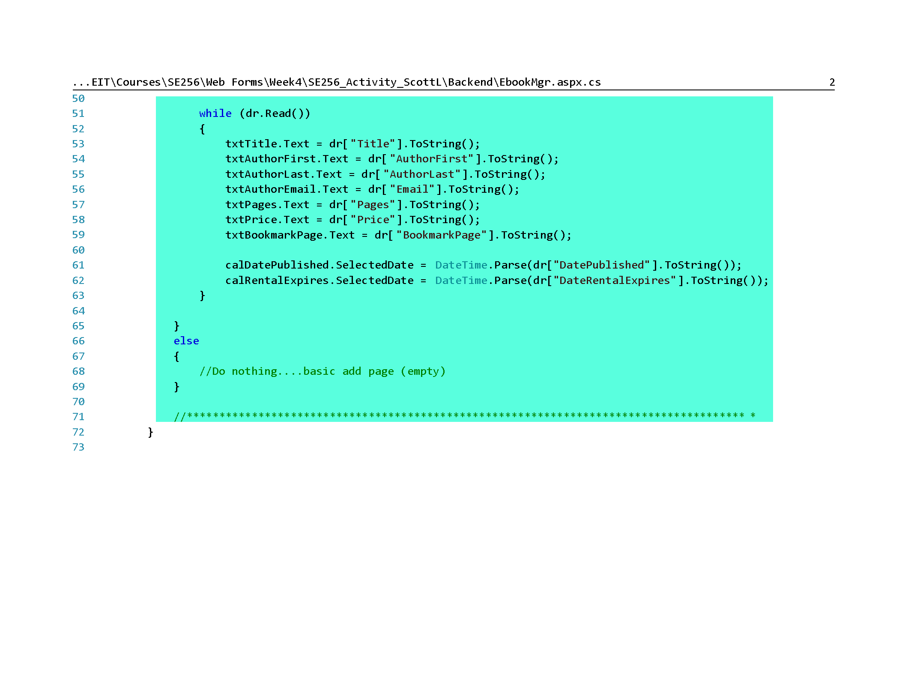

Slide 5
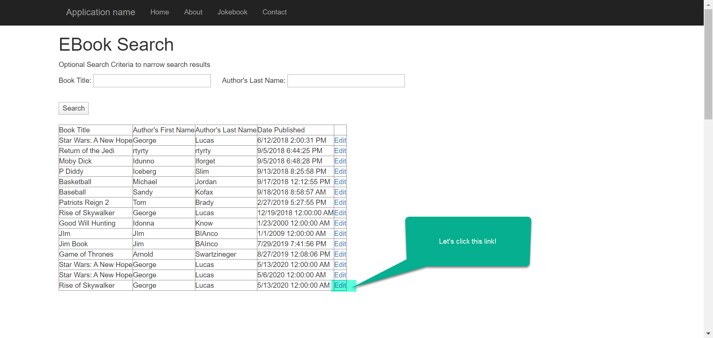

Slide 6
